Slide 1


2nd WHO Global Summit on Traditional Medicine 17-19 December 2025, New Delhi, India
Restoring balance: The science and practice of health and well-being

Slide 2
Second WHO Global Summit on TM, 2025
Background:
The 2023 Gandhinagar Summit (with the Gujarat Declaration) launched a global movement reaffirming traditional, complementary & integrative medicine (TCIM) for Universal Health Coverage and the SDGs. The 2025 Summit builds on this through inclusive, science-backed collaboration to restore balance for people and the planet.
Focus Areas:
Implementing the WHO Global Strategy for Traditional Medicine (2025–2034)
Advancing from evidence → dialogue → action
Integrating traditional knowledge with innovation (AI, genomics, digital tools)
Promoting access, regulation, and sustainability
Strengthening links between health, environment, and agriculture

Slide 3
Second WHO Global Summit on TM, 2025
Date:17–19 December 2025
Venue: Bharat Mandapam, New Delhi, India.
Theme: Restoring balance for people and planet: The science and practice of health and well-being
Organizers: WHO & Ministry of Ayush, Government of India
Vision: Restoring well-being and balance through traditional medicine and science
Goal: Deepen evidence-based understanding and integration of traditional medicine to advance health systems, equity, and sustainability
Participation: 500 in-person + 5,000 online from all WHO regions.

Slide 4

Progress since the 1st Global Summit
1st WHO TM Global Summit, 2023* Gujarat Declaration sets priority agenda | WHO TM Global Strategy, 2025 Member-state consensus established | 2nd WHO TM Global Summit, 2025 Scaling up learning, collaboration, and action
Global leadership | WHA78 agrees Global Strategy, including definitions, objectives and principles | High-level political commitments, building on UNGA, WHA, G20, BRICS, AU etc.
Research and evidence | Strategic Objective: Strengthen evidence base | Launch: TM Global Research Priorities Roadmap; WHO Bulletin series on TM Advance: TM research investments, validated innovation pipeline and equitable benefit sharing PM Yog awards
UHC, PHC health systems + data and routine information systems | Strategic Objective: Provide safe and effective TCIM, appropriate regulation | Launch: TM clinical data and research network with ICD-11 including implementation of regulation
 | Strategic Objective: Integrate safe and effective TCIM in health systems | Launch: TM Global Library with regional- and country portals with IP and equitable access
Biodiversity and sustainability; Digital health frontiers, including artificial intelligence | Strategic Objective: Strengthen cross-sectoral engagement, including community empowerment | Advance: Healthy ecosystems and TM integration; Indigenous People's knowledge exchange; Launch: AI and TM governance course/ brief
Human rights, equity and ethics | Guiding principles, including ethics, health equity and rights | Advance: Cross-cutting frameworks for TM related ethics, rights, IP, equitable access and benefits

Slide 5
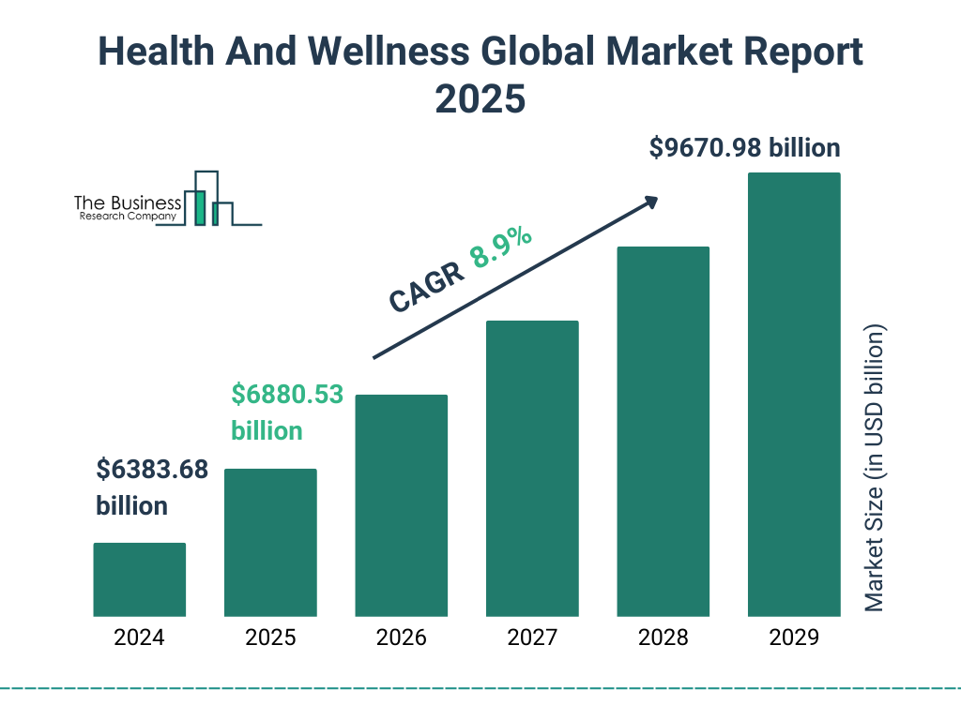


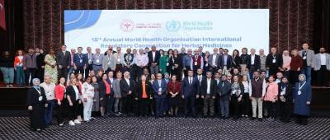
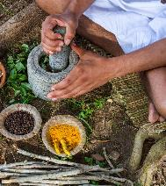
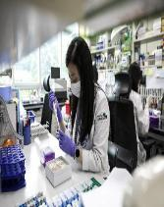

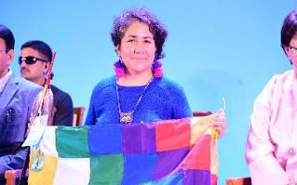

2025 Summit: Platform for major launches
Traditional Medicine Global Investment Case
WHO Traditional Medicine Global Library
Health Heritage Innovations (H2I) Investment Pipeline
Global TM Research Priorities and Roadmap
WHO Bulletin special journal issue on TM
TM systems framework and data network
Indigenous Peoples’ Knowledge Exchange
Global Partnership and Multimedia Platform

Slide 6
Draft Agenda for the Summit
Day 1​
Ministerial Round Table (forenoon)​ Thematic TM visits in Delhi (forenoon) | SUMMIT INAUGURATION (afternoon)​
Day 2​
Time | Session | Topic
9:00-10:15 am | Plenary 1 | ​ Restoring Balance​
10:15-10:45 am | Refreshment
10:45-12:00 pm | Parallel 1.A | TM and the continuum of knowledge on health​
 | Parallel 1.B | TM knowledge – balancing access and benefits​
 | Parallel 1.C | TM in rebalancing ecosystems for planetary health
 | Parallel 1.D | TCIM – bringing balance to governance, equity, and resources​
12:00-12:45 pm | Expo Thematic Experience
12:45-1:45 pm | Lunch
1:45-2:30 pm | Restoring Balance Practice Session
2:30-3:45 pm | Plenary 2 | ​ Investing in science to drive TM progress
3:45-4:15 pm | Refreshment
4:15-5:30 pm | Parallel 2.A | Research priorities and roadmap​
 | Parallel 2.B | Methods of enquiry
 | Parallel 2.C | Innovation evaluation criteria​/ Innovation pipeline​
 | Parallel 2.D | Strengthening the TCIM investment case​
5:30-6:15 pm | Expo Thematic Experience
7:00-8:30 pm | Summit Gala Dinner
Day 3​
9:00-10:15 am | Plenary 3 | ​ Re-imagining Health Systems​
10:15-10:45 am | Refreshment | 10:15-10:45
10:45-12:00 pm | Parallel 3.A | TCIM and Health Systems Integration Global Framework and Country Implementation​
 | Parallel 3.B | TCIM and quality, efficiency and resilience of health systems. Patient centric approaches​
 | Parallel 3.C | Regulation, and capacity building, for TCIM products, practices, and workforce​
 | Parallel 3.D | Integrating TCIM data in national RHI systems with ICD, ICHI standards​
12:00-12:45 pm | Expo Thematic Experience
12:45-1:45 pm | Lunch
1:45-2:15 pm | Restoring Balance Practice Session
2:15-3:30 pm | Plenary 4: | Equity, Sustainability, and Accountability​
3:30-4:00 pm | Refreshment
4:00-5:15 pm | Parallel 4.A | Knowledge paradigms​ in Health – TCIM, Indigenous Knowledge, and Biomedicine
 | Parallel 4.B | TM / Indigenous / Ancestral knowledge – dimensions of equity and sustainability​
 | Parallel 4.C | Digital Frontiers: Harnessing AI and Digital Health for the Future of Traditional Medicine
 | Parallel 4.D | Building inclusive global movement for TM with equity, voice, participation, accountability​
5:15-6:30 pm | Plenary 5 | Closing​- Summit Commitments: Multistakeholder Action Agenda for the implementation of the Traditional Medicine Strategy​

Slide 7
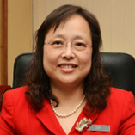
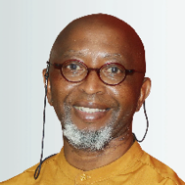
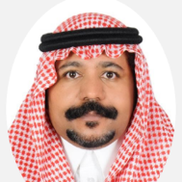
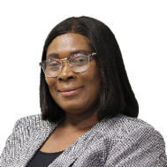
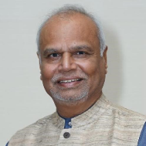
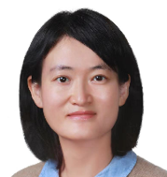
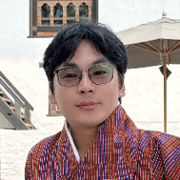
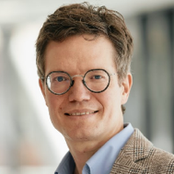
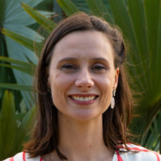
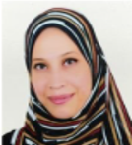
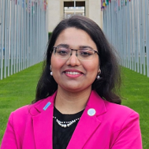
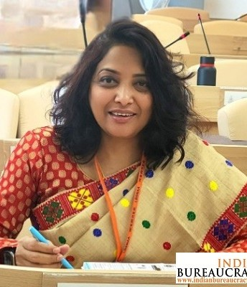
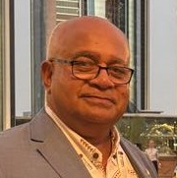
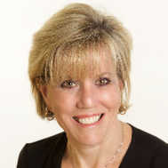
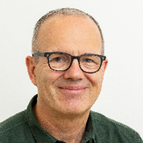
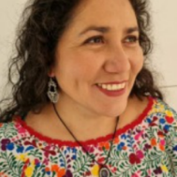
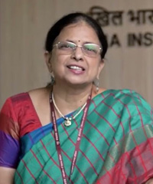
2025 Global Summit Steering Committee
Dr Goh Cheng Soon Ministry of Health, Malaysia
Prof Motlalepula Matsabisa U of Free State, South Africa
Dr Abdullah O Alanazi Ministry of Health, S Arabia
Dr Anastasia Yirenkyi Ministry of Health, Ghana
Dr Bhushan Patwardhan National Ayush Professor, India
Dr Chunyu Wei National Administration of Traditional Chinese Medicine
Dr Dorji Gyeltshen National Traditional Medicine Hospital, Bhutan
Dr Holger Cramer University of Tubingen, Germany
Dr Mariana Cabrel Schveitzer Universidade Federal de São Paulo, Brazil
Dr Nessma El-Sayed Mohamed Ali General Administration for Registration of Herbal Products, Egypt
Ms Tanushree Jain International Pharmaceutical Students Federation
Monalisa Dash IFoS, Joint Secretary, Ministry of Ayush, Government of India
Mr Sione Tu'ithai Health Promotion Forum of New Zealand
Ms Susan Sheridan Patient Safety Movement, USA
Dr Tido von Schoen-Angerer TCIH Coalition, Switzerland
Dr Viviana Camacho Hinojosa Ministry of Health, Bolivia
Tanuja Nesari Director, Institute of Teaching and Research in Ayurveda

Slide 8
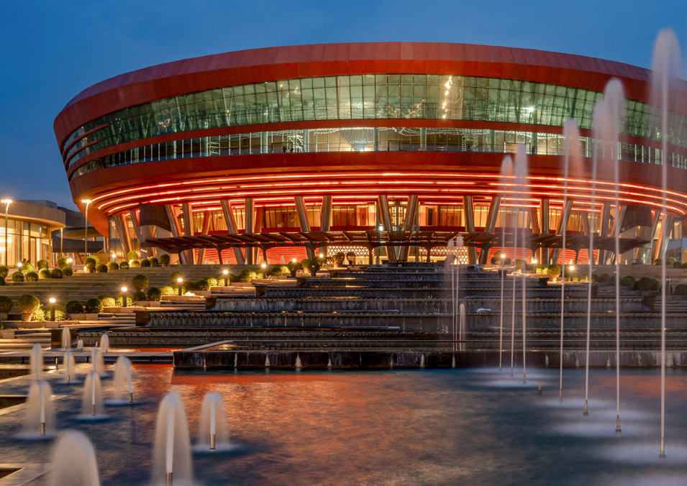
Innovation Expo
Innovative, immersive «experience space»
Interactive journey to explore how TM is essential to the past, present, and future of medical and scientific frontiers
Participants can test their knowledge and learn new skills, in science and practice, to restore balance.
Committee has been formed from Indian side for the Expo and there will be a dedicated Ashwagandha corner

Slide 9
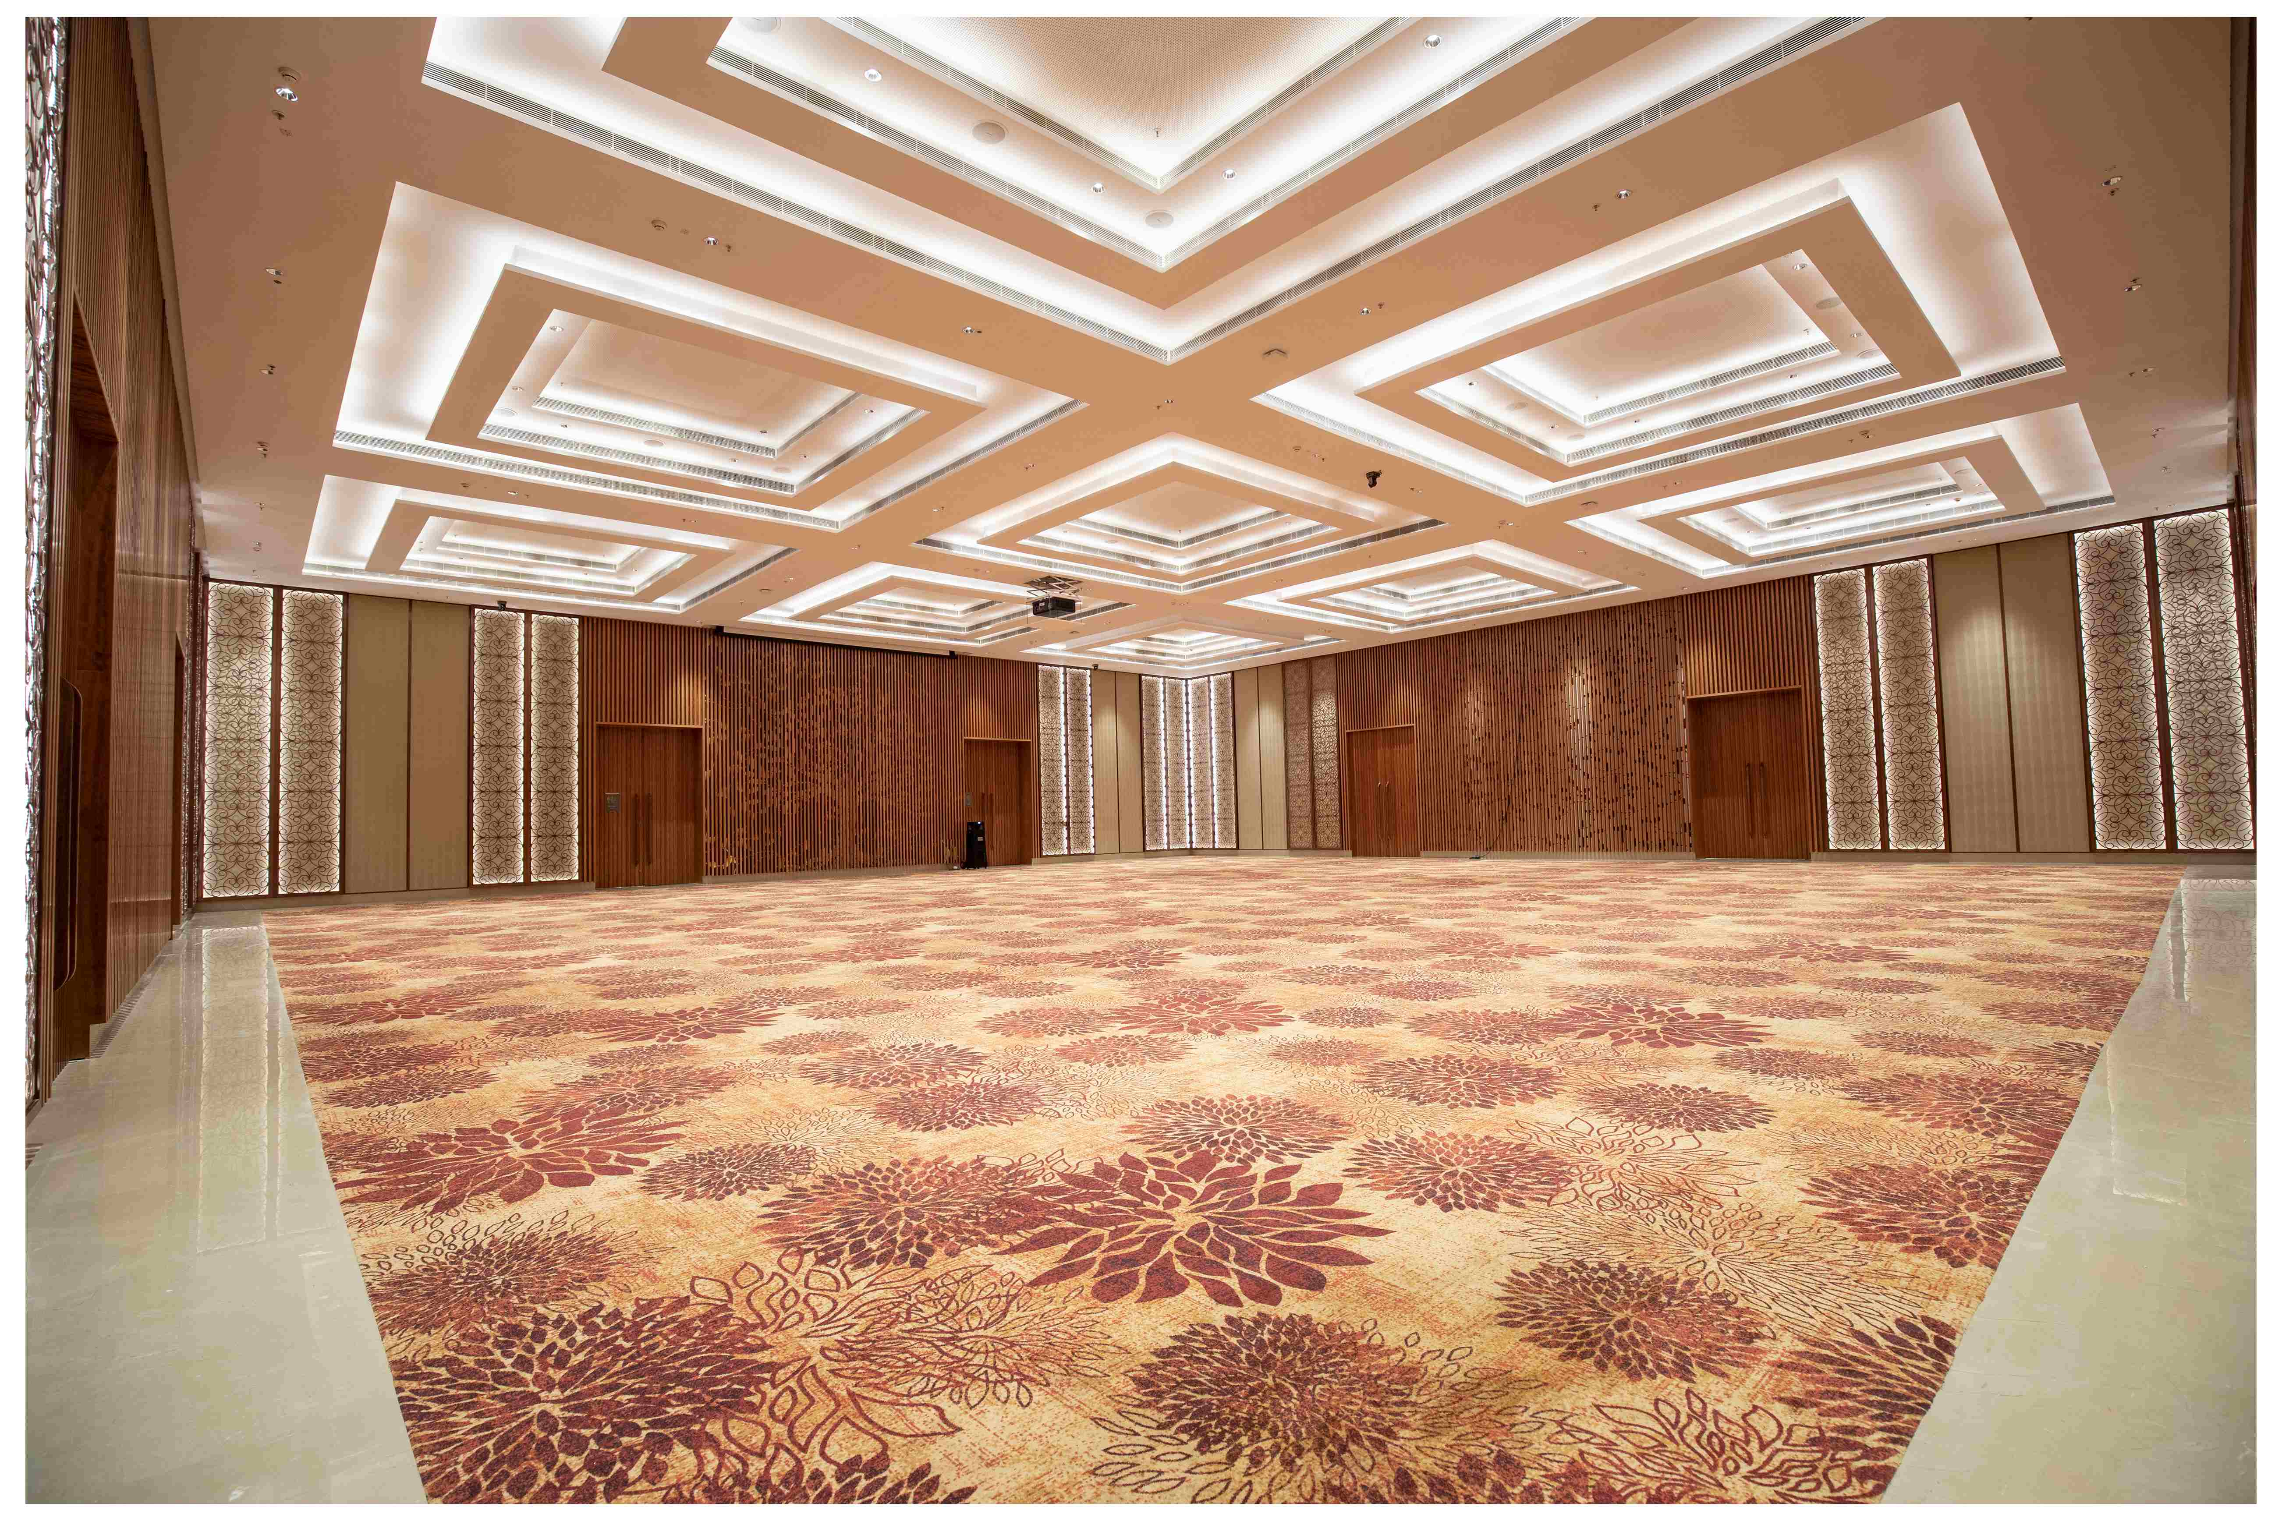
2025 Global Summit: Inauguration
Inauguration, Wed 17 Dec, 2PM, Bharat Mandapam 3/F, Multipurpose Hall
Invited chief guest: Hon’ble Prime Minister Narendra Modiji and Director General, WHO
Remarks from GoI and WHO, including DG Tedros, Hon Minister Ayush
Seating: Up to 1,200 + media
Dynamic introduction of Summit and Expo content, with multimedia highlights and remote video participation from around the world
Field trips, 9-12pm, Wed 17 Dec
Four parallel field visits for all invited Summit participants, self-selected in advance of Summit
Locations and programmes in Delhi to be co-designed by Ministry of Ayush and WHO GTMC
In-person participation; no remote viewing planned

Slide 10

Ministerial Round Table Dialogue-Wed 17 Dec, 05-6:30 PM
Discussion of how to galvanize commitment and progress for TM in line with new Global Strategy aims
Exchange country experiences, lessons, successes;
Strengthen multilateral cooperation on TM
Commitment towards WHO indicators

Slide 11

Invitation Status
Joint Invitation to be sent by WHO
In person: Approx 700 for Summit, 1,200 for inauguration
350 Sponsored WHO international invitations (6 regions x 50 + 50 HQ). Submit by 17 October, 200 Sponsored GoI invitations.
Additional: Non-sponsored WHO international invitations: 120 (6 regions x 20) 30 from Ministry of Ayush.
17 Sept: Circular letter to all WHO member-states via missions, with 27 Oct deadline for expression of interest to send sponsored government delegation of up to three members
Ongoing: Sponsored travel arrangements decentralized through WHO regional offices with dedicated focal points; centralized travel planning and registration list through WHO Tunis Centre
Joint Invitation from Hon’ble Minister of Ayush and WHO Regional Director
1 Nov: Co-signed invitation letters from Hon Minister Ayush and WHO Regional Director to be sent to all interested Ministers (MEA guidance sought-32 list of countries have been identified)
Invitations to be extended from Ministry of Ayush
Ambassadors / missions at Delhi
Heads of state yet to be identified with the support of MEA.

Slide 12

Invitation Status- Continue..
Virtual participation: Up 5,000 online
Dedicated Summit microsite to be launched in October with invitation to register online for remote viewing
Summit and Expo broadcast in December to focus on participatory engagement (chat, quizzes, polls), and live/pre-recorded interventions by remote speakers and events

Slide 13

Countries for bilateral discussions in the sideline of the Summit
Brazil
Bolivia
Cuba
Japan
Colombia
Germany
Netherlands
Sri Lanka
United Kingdom
United States
Mauritius
Indonesia
Malaysia
Philippines
Thailand
Nepal
Oman
Ghana

Slide 14
Responsibilities for the Global Summit on Traditional Medicine 2025
Responsibility Area | Ministry of Ayush (Govt. of India) | WHO
Accommodation | For ministers, high-level officials, and liaison officers | For participants (up to 200 rooms), booked at negotiated rates
Venue booking | Venue booking, suitably equipped offices for WHO, furniture, equipment, services, appropriate infrastructure, and local staff necessary for the work of the Global Summit. | --------
Transportation | For ministers, high-level officials, and liaison officers | Airport-hotel-venue transfers for all participants
Event Management Company | — | Event Management Company (EMC) hired by WHO
Support Staff | — | Hired via EMC: security, ushers, technicians, media, cleaners, etc.
Medical Facilities | On-site first aid; emergency hospital access (treatment not covered) | —

Slide 15
Responsibilities for the Global Summit on Traditional Medicine 2025
Responsibility Area | Ministry of Ayush (Govt. of India) | WHO
Reception Services | — | Special reception desk at New Delhi airport (domestic and international terminals)
Customs and Equipment | Facilitate duty-free import/export of WHO equipment | —
Security & Protocol | Coordinate with Delhi Police and agencies for ministerial protocol and overall security | —
Participant Coordination | Assign contact person for liaison on transport matters | List of persons attending or participating in the Global Summit will be forwarded by WHO to MoA Manage participant arrivals/departures
Liability for Damages/Accidents | Assumes liability (excluding gross negligence by WHO officials) | —
Reception Services | — | Special reception desk at New Delhi airport (domestic and international terminals)

Slide 16








Progress towards the Summit by WHO and MoA
June
July
August
September
October
November
December
First meeting of GoI-WHO Summit Planning Group; MoU agreed, CCRAS (nodal agency),
Draft agenda circulated; high-level invitations sent by WHO
Summit website launched; registration opens
Nominations finalized for sponsored participation by WHO, Committee formed, Venue booked, Letter to DG (WHO), PMO and Delhi Police sent
Detailed Global Summit programme posted online, Speaker’s list, letter to MEA & MHA sent, Visit to Bharat Mandapam by Ayush Officials
3rd SPG meeting, invitation to 200 participants by GoI, Joint Invitation to foreign health Ministers
Construction of Summit meeting and expo space begins at Bharat Mandapam,
Global Summit and Expo
2nd SPG meeting (25.09.2025)
1st SPG (Summit Plannig Group) meeting (26.06.2025)
3rd SPG meeting (first week of November 2025)
Agreement signed for the Global Summit on TM

Slide 17
Expectations from the Ministry of External Affairs
Protocol support & International Media
Delhi chapters of Ambassadors
Identification of Heads of State to be invited
Video call meeting with Ambassadors of East and West to push their country delegation

Slide 18
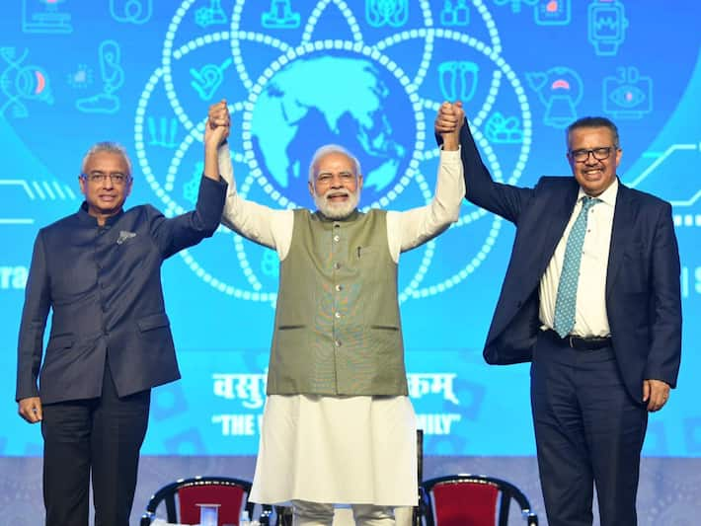
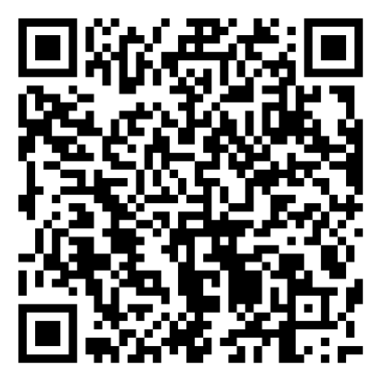
THANK YOU
tmsummit@who.int

